Slide 1
Lecture 11 WiFi PHY
CS397/497 – Wireless Protocols for IoT
Branden Ghena – Winter 2021

Slide 2
Today’s Goals
Discuss WiFi physical layers
Get a feel for what choices are leading to more throughput
Think a little about what the costs of that are

Slide 3
Outline
WiFi Overview
WiFi PHY
802.11/802.11b
802.11a/802.11g
802.11n/802.11ac
Real-World WiFi

Slide 4
What is WiFi?

Slide 5

What is WiFi?
(That title is a joke. Even my grandparents know what WiFi is.)
WiFi is the most successful wireless protocol.

Slide 6


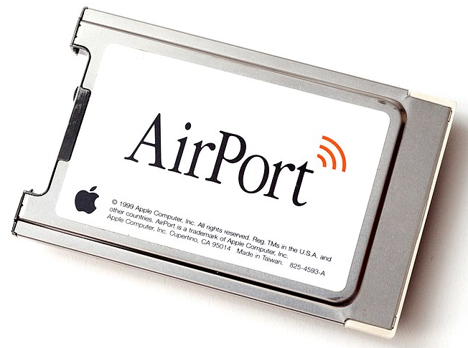
802.11 timeline
1985 – US FCC rules ISM band for unlicensed use
1990s – WaveLAN (NCR Corporation, Netherlands)
Wireless ethernet for cashier systems
1997 – 802.11 specification
1999 – 802.11b and 802.11a amendments
1999 – WiFi Alliance formed for certification of devices
1999 – Apple iBook is the first consumer WiFi product

Slide 7
Major amendments
802.11b was very popular but is now usually unsupported
802.11a never saw major deployment
WiFi Alliance rebranded 802.11ac as “WiFi 5” and backported scheme
 | Protocol | Year | Frequency | PHY | Max Rate | Range
- | 802.11 | 1997 | 2.4 GHz | DSSS/FHSS | 2 Mbps | 20 m
1 | 802.11b | 1999 | 2.4 GHz | DSSS | 11 Mbps | 35 m
2 | 802.11a | 1999 | 5 GHz | OFDM | 54 Mbps | 35 m
3 | 802.11g | 2003 | 2.4 GHz | OFDM | 54 Mbps | 38 m
4 | 802.11n | 2009 | 2.4/5 GHz | OFDM + MIMO | 600 Mbps | 70 m
5 | 802.11ac | 2013 | 5 GHz | OFDM + MIMO | 3.4 Gbps | 35 m

Slide 8
Resources
Peter Steenkiste – Carnegie Mellon University
https://www.cs.cmu.edu/~prs/wirelessS18/handouts/L11-AdHoc.pdf
https://www.cs.cmu.edu/~prs/wirelessS18/handouts/L12-LAN.pdf
Raj Jain – Washington University in Saint Louis
https://www.cse.wustl.edu/~jain/cse574-14/ftp/j_05lan.pdf
https://www.cse.wustl.edu/~jain/cse574-14/ftp/j_06lan.pdf
Honestly
https://en.wikipedia.org/wiki/IEEE_802.11

Slide 9
Outline
WiFi Overview
WiFi PHY
802.11/802.11b
802.11a/802.11g
802.11n/802.11ac
Real-World WiFi

Slide 10
WiFi Physical Layer
Details start to get pretty messy here for multiple reasons:
Different countries/regions have different standards
Channels look a little different in different areas
WiFi has evolved over the last 20 years
Different features are designed for different amendments
WiFi is focused on improving throughput
Solutions that were initially “too complicated” no longer are

Slide 11
Goal: improve throughput
In twenty years, WiFi has gone from 2 Mbps to 3 Gbps
How does a network improve its throughput?

Slide 12
Goal: improve throughput
In twenty years, WiFi has gone from 2 Mbps to 3 Gbps
How does a network improve its throughput?
More capable modulation and/or bit transmission
Techniques like OFDM and MIMO
More bandwidth
Increased channel with at 2.4 Ghz and bigger 5 GHz channels

Slide 13
Walking through PHY changes by amendment
 | Protocol | Year | Frequency | PHY | Max Rate | Range
- | 802.11 | 1997 | 2.4 GHz | DSSS/FHSS | 2 Mbps | 20 m
1 | 802.11b | 1999 | 2.4 GHz | DSSS | 11 Mbps | 35 m
2 | 802.11a | 1999 | 5 GHz | OFDM | 54 Mbps | 35 m
3 | 802.11g | 2003 | 2.4 GHz | OFDM | 54 Mbps | 38 m
4 | 802.11n | 2009 | 2.4/5 GHz | OFDM + MIMO | 600 Mbps | 70 m
5 | 802.11ac | 2013 | 5 GHz | OFDM + MIMO | 3.4 Gbps | 35 m

Slide 14
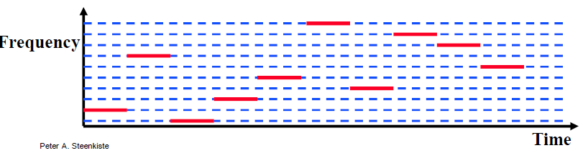
Original WiFi specification (1997)
Legacy WiFi
Frequency Hopping Spread Spectrum (FHSS)
GFSK (Gaussian Frequency-Shift Keying)
Relatively simple radio design
Frequency hopping over 80 channels (1 MHz each)
Actually supports an Infrared PHY as well!!

Slide 15
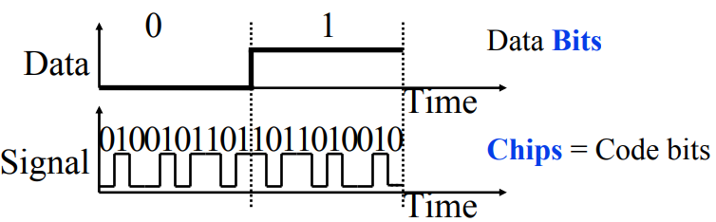
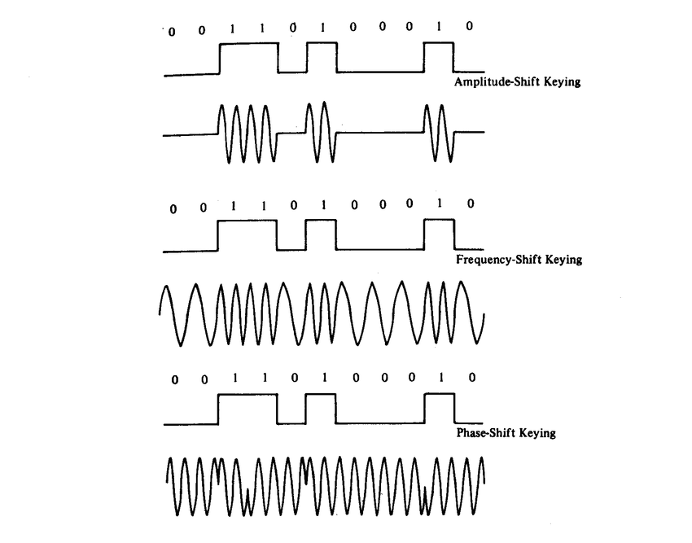
802.11b (1999)
802.11b
Direct Sequence Spread Spectrum (DSSS)
DBPSK and DQPSK (Differential Binary/Quadrature Phase-Shift Keying)
Translate data into “codes”
Each data bit corresponds to several code bits (Chips)
Chips are what is actually modulated over the air
Data can be recovered by knowing the code patterns
Modulation
Phase-shift Keying (of the Chips)

Slide 16
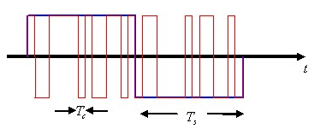
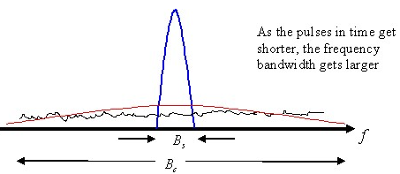
DSSS goals
DSSS increases bandwidth of a signal
Beyond what is needed for the data
Energy is smeared across the frequencies
More robust against interference
Narrowband signals knock out only part of the signal
Data can be recovered from partial code
Cost: using a lot of bandwidth for only a little data

Slide 17
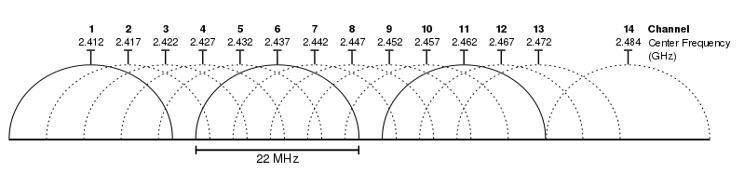
802.11b channels
14 channels total
1-11 for US
1-13 for most of the rest of the world
1-14 for Japan (but 14 only for 802.11b
22 MHz channels
5 MHz spacing -> significant channel overlap
Channels 1, 6, and 11 can be used without overlap

Slide 18
Walking through PHY changes by amendment
 | Protocol | Year | Frequency | PHY | Max Rate | Range
- | 802.11 | 1997 | 2.4 GHz | DSSS/FHSS | 2 Mbps | 20 m
1 | 802.11b | 1999 | 2.4 GHz | DSSS | 11 Mbps | 35 m
2 | 802.11a | 1999 | 5 GHz | OFDM | 54 Mbps | 35 m
3 | 802.11g | 2003 | 2.4 GHz | OFDM | 54 Mbps | 38 m
4 | 802.11n | 2009 | 2.4/5 GHz | OFDM + MIMO | 600 Mbps | 70 m
5 | 802.11ac | 2013 | 5 GHz | OFDM + MIMO | 3.4 Gbps | 35 m

Slide 19
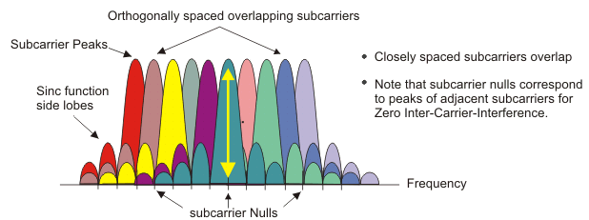
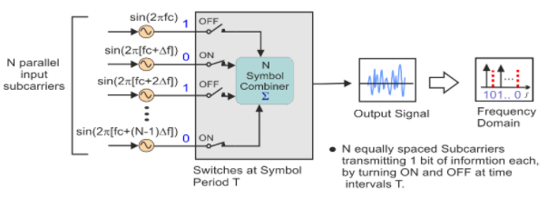
OFDM enables higher throughput
Replace DSSS with Orthogonal Frequency Division Multiplexing
OFDM idea
Split band into a number of narrow subcarriers
Subcarriers are spaced so that they don’t interfere
Transmit on multiple subcarriers at once to increase throughput

Slide 20
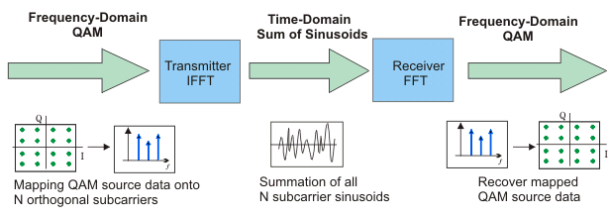
OFDM enables higher throughput at complexity cost
Receivers collect signal from entire channel
And then can split it apart to gain the data on each subcarrier
Tradeoffs
Benefits: more throughput, still robust against narrowband interference
Costs: more complicated and sensitive radio design

Slide 21
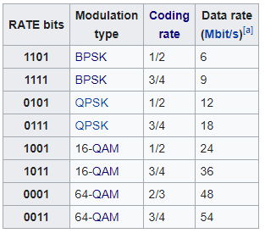
802.11a (1999)
Applied OFDM techniques on the 5 GHz band
Enabled more data throughput 54 Mbps (compare to 11 Mbps for 802.11b)
Multiple rates available
BPSK/QPSK/QAM over OFDM
Quadrature Amplitude Modulation (QAM)
Never reached widespread adoption
Regulatory hurdles in some regions
More complicated hardware delayed it

Slide 22
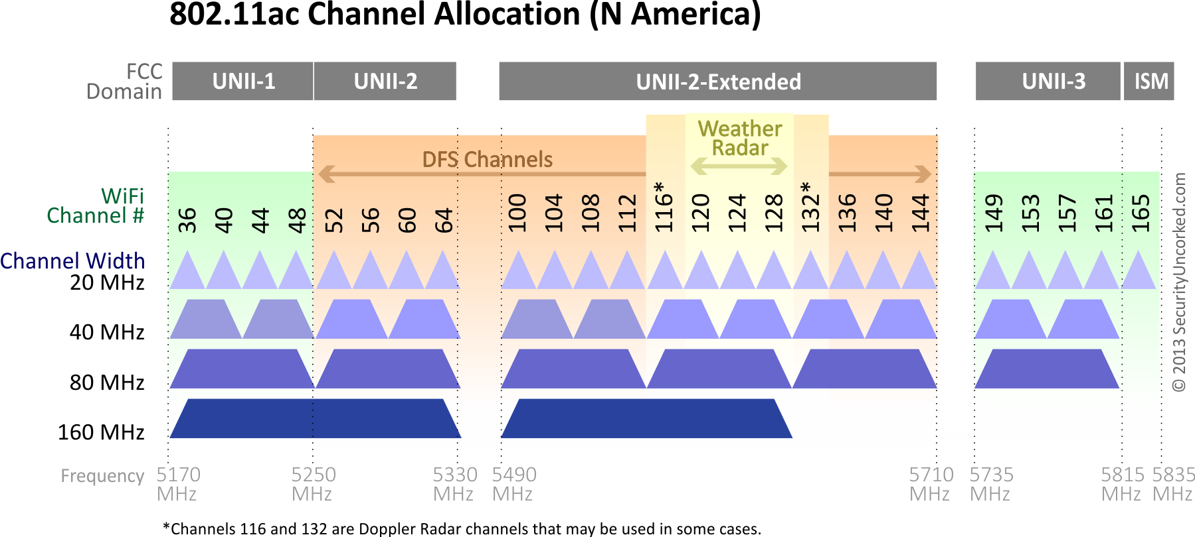
802.11a channels
802.11a did promote the use of 5 GHz band
Several 20 MHz channels with no overlap
Big increase from “three” channels of 2.4 GHz
Various regional rules on a number of different channels
Needs to avoid frequencies in use by existing radar deployments
Orange channels aren’t used in the US at least, except for enterprise

Slide 23
802.11g (2003)
Applies OFDM to 2.4 GHz band
Increases throughput from 11 Mbps to 54 Mbps
Repeats rate choices of 802.11a but on more support 2.4 GHz band
Same 2.4 GHz channels as 802.11b, but 20 MHz bandwidth
Still 1, 6, 11 in US
1, 5, 9, 13 in other regions
Backwards compatible with 802.11b
Capable of DSSS communication when required

Slide 24

Cost of supporting 802.11b
802.11g uses a completely different PHY layer than 802.11b
DSSS -> OFDM
Unintelligible to old receivers creating an interoperability problem
Interoperability mode: send part of message in old format
DSSS header with OFDM payload
Adds overhead and slows down the entire network
Starting with 802.11n, routers don’t support 802.11b by default

Slide 25
Improved WiFi hardware is in high demand
Typically, standards lead hardware by several years
BLE 5.2 is out, but 5.0 is just being adopted in phones
Development of 802.11g hardware started before finalization of standard
Demand for increased performance was already high in 2003
Phenomena continues in modern WiFi and Cellular protocols
Hardware supports some features as soon as it’s clear they’ll exist

Slide 26
Walking through PHY changes by amendment
 | Protocol | Year | Frequency | PHY | Max Rate | Range
- | 802.11 | 1997 | 2.4 GHz | DSSS/FHSS | 2 Mbps | 20 m
1 | 802.11b | 1999 | 2.4 GHz | DSSS | 11 Mbps | 35 m
2 | 802.11a | 1999 | 5 GHz | OFDM | 54 Mbps | 35 m
3 | 802.11g | 2003 | 2.4 GHz | OFDM | 54 Mbps | 38 m
4 | 802.11n | 2009 | 2.4/5 GHz | OFDM + MIMO | 600 Mbps | 70 m
5 | 802.11ac | 2013 | 5 GHz | OFDM + MIMO | 3.4 Gbps | 35 m

Slide 27
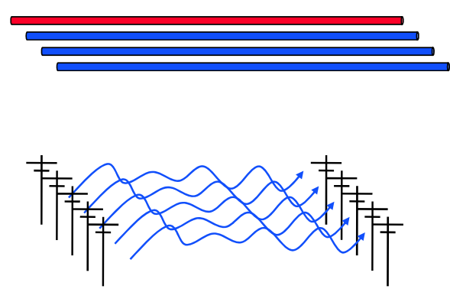
How do we increase throughput?
Wired world
Add more wires in parallel
Wireless world
Add more antennas?

Slide 28
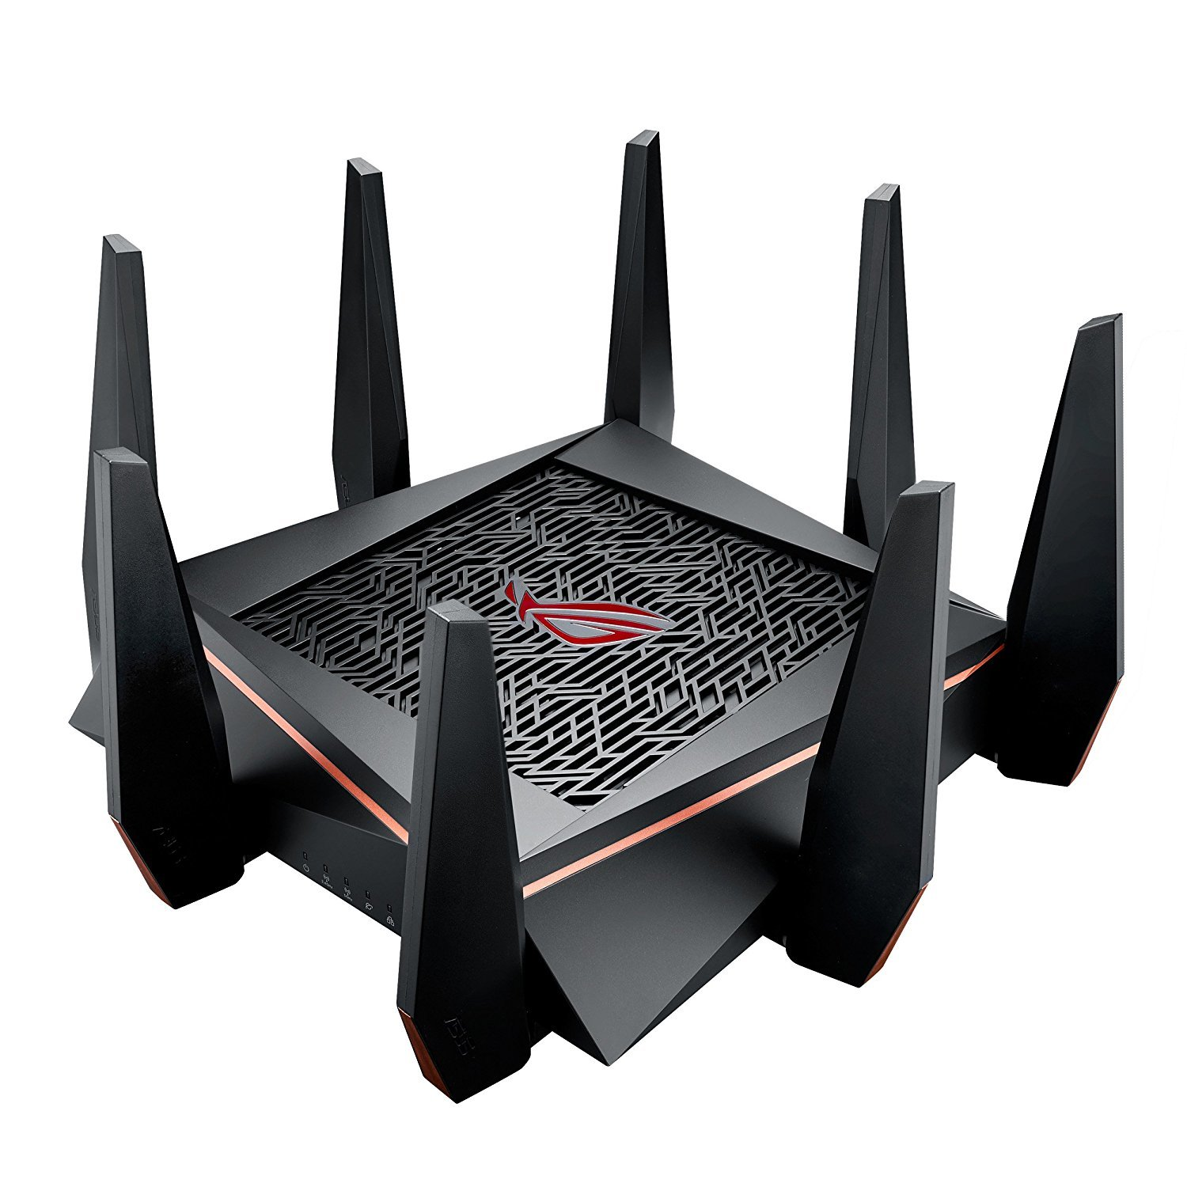
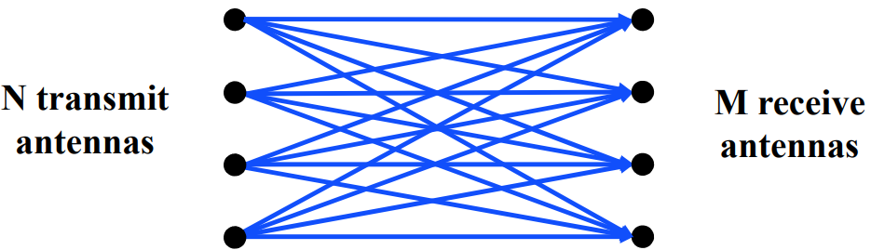
MIMO – Multiple In Multiple Out
N x M subchannels can be used to send data simultaneously
Huge boost in data throughput
Antenna diversity adds to reliability as well
The signals may interfere with each other
But receiving all of them allows the data to be recovered
Beamforming
Use interactions between array of antennas to focus energy on the receiver
Way outside of the scope of this class

Slide 29
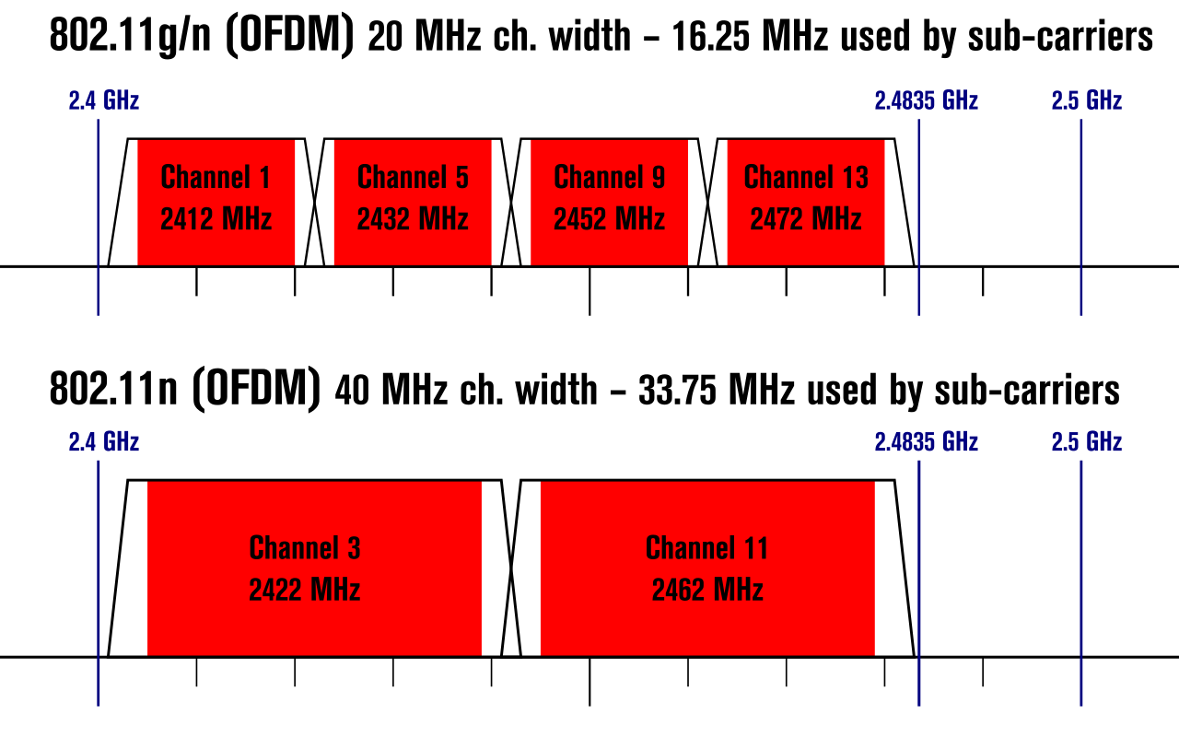
Expandable bandwidth
OFDM allows many subcarriers within a channel to be used at once
Throughput scales with the amount of bandwidth available
Allow larger 40 MHz channels to be used

Slide 30
802.11n (2009)
Supports OFDM and MIMO on 2.4 GHz and 5 GHz
Supports 20 MHz and 40 MHz channels
Easier to create large channels in 5 GHz band
Backwards compatible with 802.11g (tries not to be with 802.11b)
Wildly successful
Still the 2.4 GHz band protocol (802.11ac is 5 GHz only)
A little less than half of the networks visible to me are still 802.11n
The “building WiFi” is still 802.11g…

Slide 31
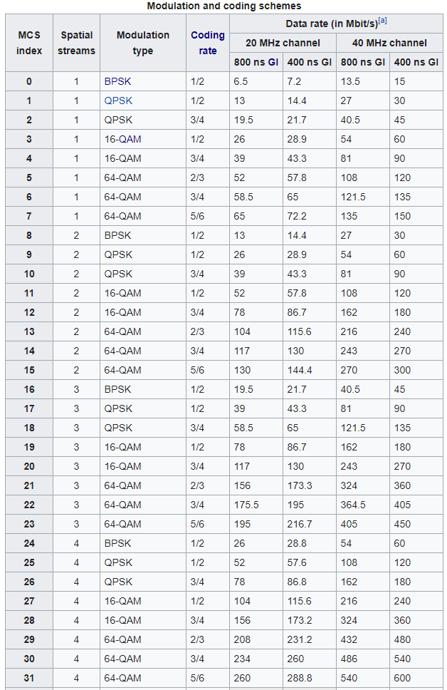
802.11n modulation and coding schemes
MCS – Modulation and Coding Scheme
GI – Guard Interval: delay between transmitted symbols

Slide 32
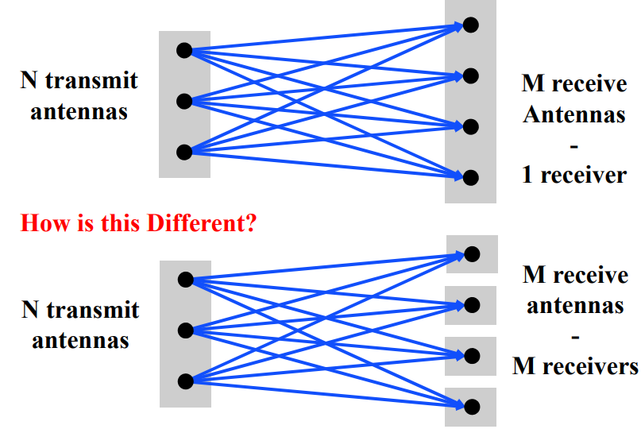
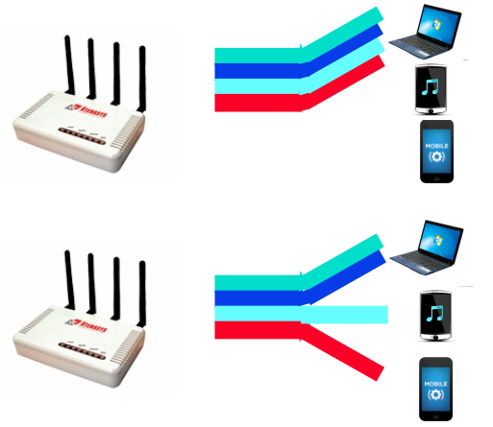
Multi-user Multiple In Multiple Out (MU-MIMO)
Multi-user MIMO uses the same techniques to send in parallel to multiple devices
Devices cannot cancel out interference anymore
Send slower, more reliable data streams to overcome this

Slide 33
802.11ac (2013)
Update for 5 GHz band only
Supports Downlink MU-MIMO (from AP to device)
Supports channels widths up to 160 MHz
Engineering updates: up to 256-QAM
Routers apply 802.11ac to 5 GHz and 802.11n to 2.4 GHz

Slide 34
802.11ac channels

Slide 35
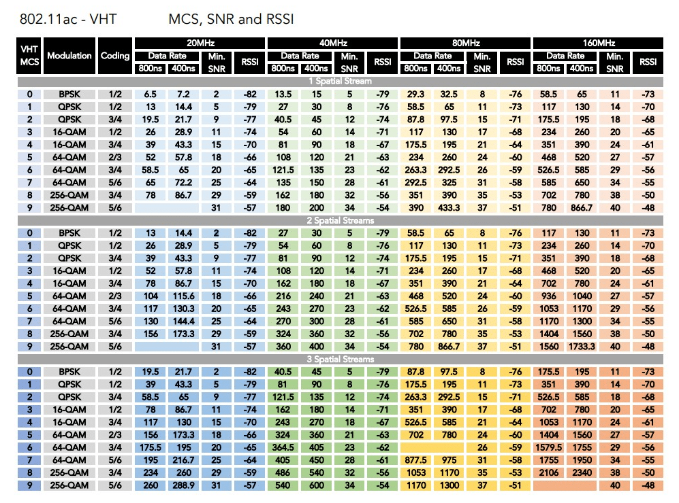
802.11ac modulation and coding schemes
4 spatial streams is also allowed, getting up to 3466 Mbps

Slide 36
Outline
WiFi Overview
WiFi PHY
802.11/802.11b
802.11a/802.11g
802.11n/802.11ac
Real-World WiFi

Slide 37
Goal: improve throughput
In twenty years, WiFi has gone from 2 Mbps to 3 Gbps
How does a network improve its throughput?
More capable modulation and/or bit transmission
Techniques like OFDM and MIMO
Original 2 Mbps -> 54 Mbps with OFDM -> 346 Mbps with MIMO (100x)
Engineering improvements are baked into these steps too
More bandwidth
Increased channel with at 2.4 Ghz and bigger 5 GHz channels
346 Mbps with 20 MHz -> 3466 Mbps with 160 MHz (10x)

Slide 38
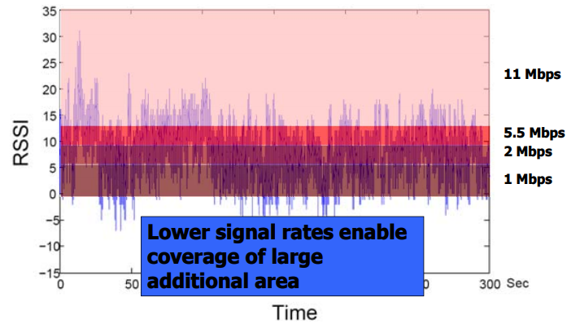
Bit rate adaptation
All modern WiFi standards support multiple bit rates (MCS)
Many factors can influence the choice of bit rate
Capability of device: not all devices support all bit rates
Range and packet reliability (interference)

Slide 39
Bit rate adaptation
Selecting the right rate at the right time is a complex problem
And needs to be decided per-device
Trial and Error
Failures -> reduce rate
Successes -> increase rate
Signal strength
Use channel state information to decide
Context sensitive
Mobile devices need lower rates

Slide 40
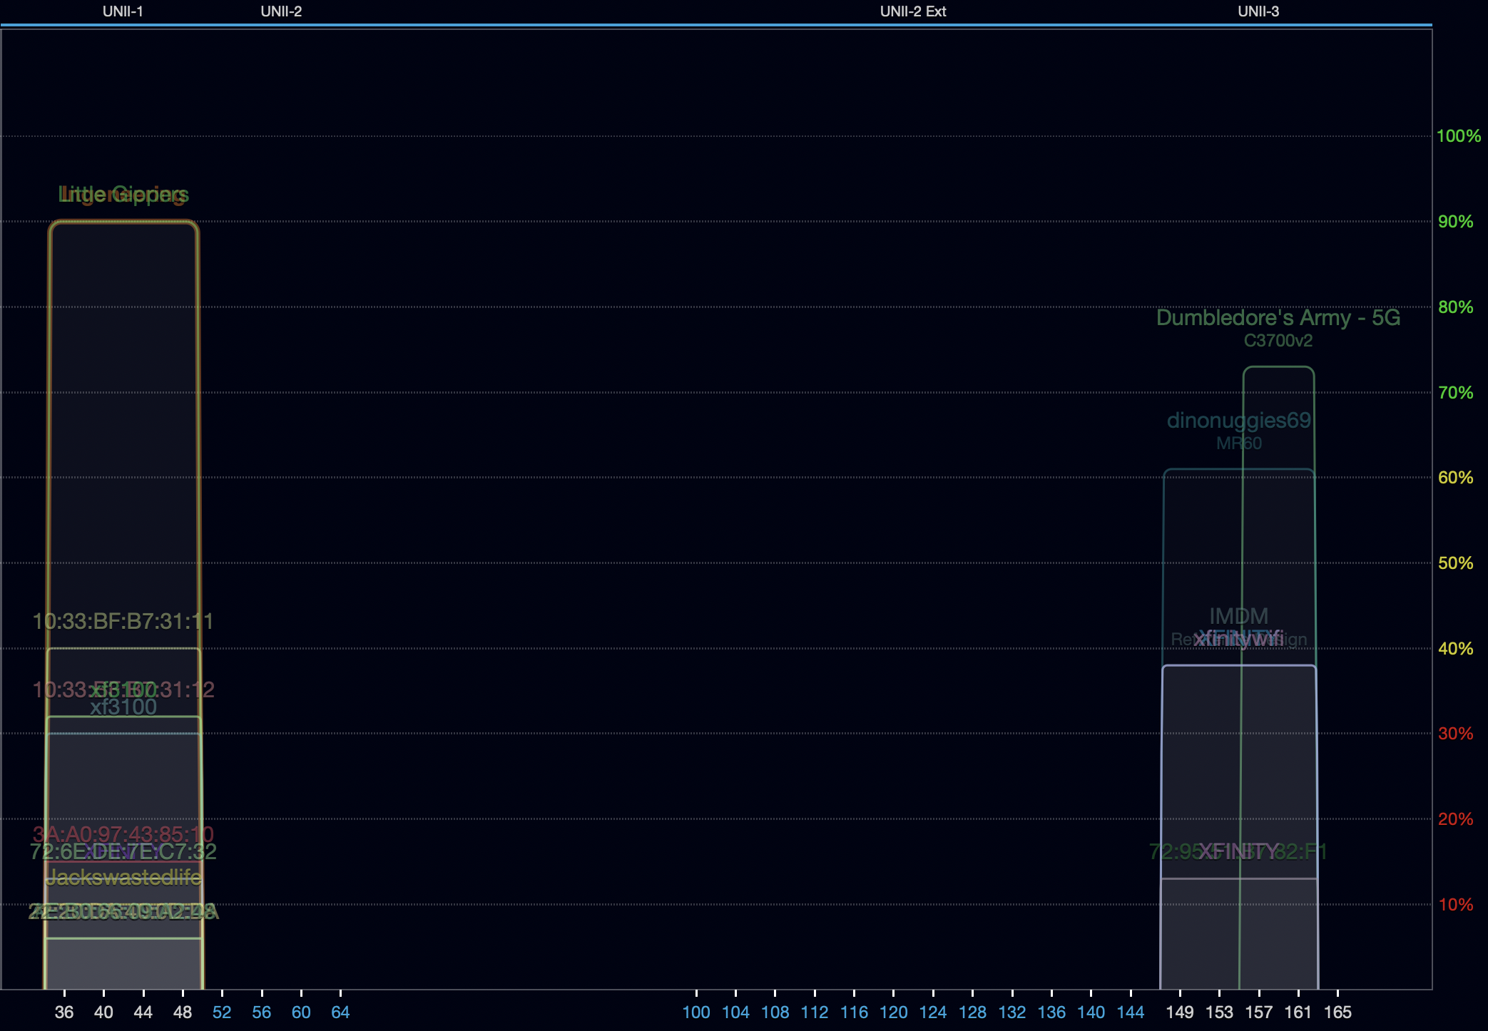
Real-world 802.11 channel use – 5 GHz
Devices use 80 MHz channels almost entirely
One network using 40 MHz channel
No use of the more complicated bands
Why is no one using channel 165?

Slide 41
Real-world 802.11 channel use – 5 GHz
Devices use 80 MHz channels almost entirely
One network using 40 MHz channel
No use of the more complicated bands
Why is no one using channel 165?
That would be a 20 MHz channel
And can’t be added on its own

Slide 42
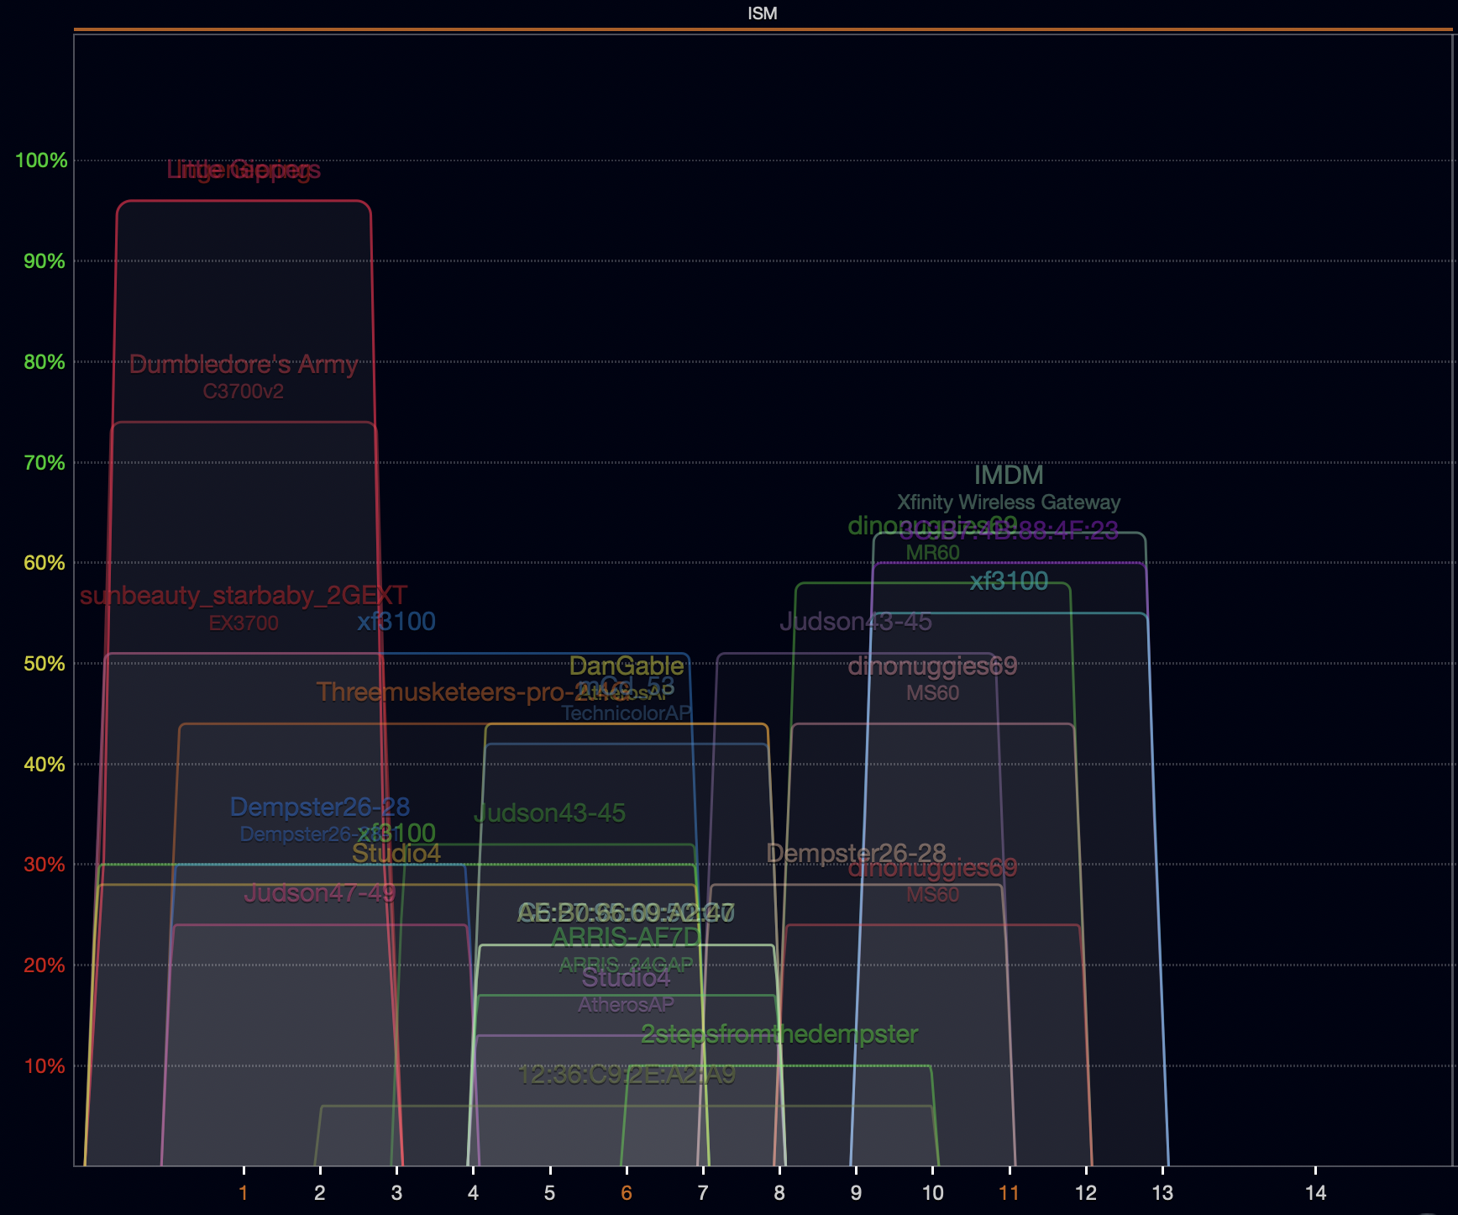
Real-world 802.11 channel use – 2.4 GHz
Most networks use 20 MHz channels 1, 6, or 11
Just use 5 GHz for faster speeds
Several networks create 40 MHz allocations

Slide 43
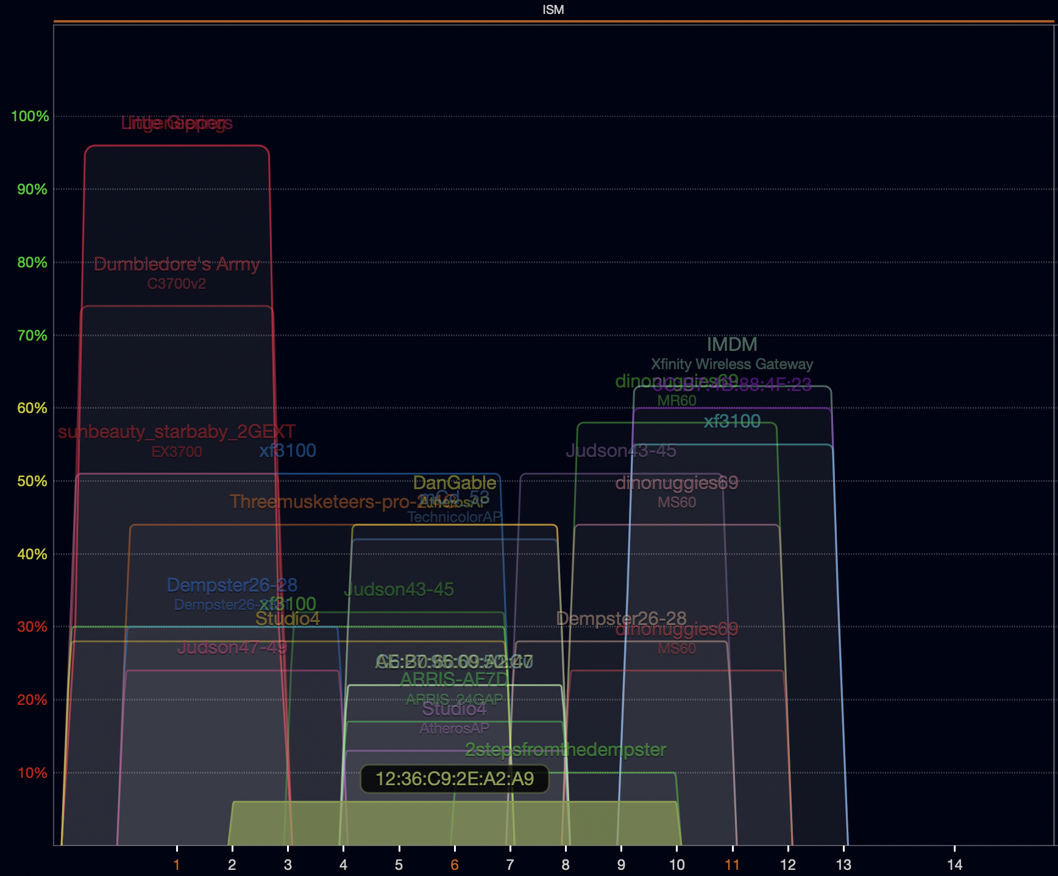
Real-world 802.11 channel use – some routers are weird
Some networks are weird
Why make a 40 MHz allocation centered on channel 6??!
Some 20 MHz networks use channels 2, 9, or 10

Slide 44
Outline
WiFi Overview
WiFi PHY
802.11/802.11b
802.11a/802.11g
802.11n/802.11ac
Real-World WiFi

